Slide 1
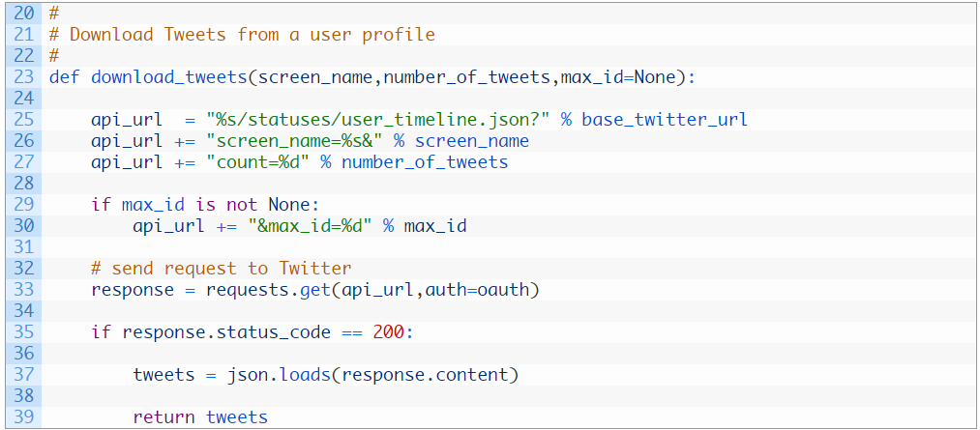
Unit 4:download full list of tweets
Although very similar to the script in Unit 3 …
We’ve changed the function definition to include the max_id parameter.
When we put the max_id = None in the function definition that means that by default max_id will equal None and otherwise we need to pass in a value
here we are testing whether max_id is None or not. If it is set to a value then we simply append it as a URL parameter before sending off to the Twitter API

Slide 2
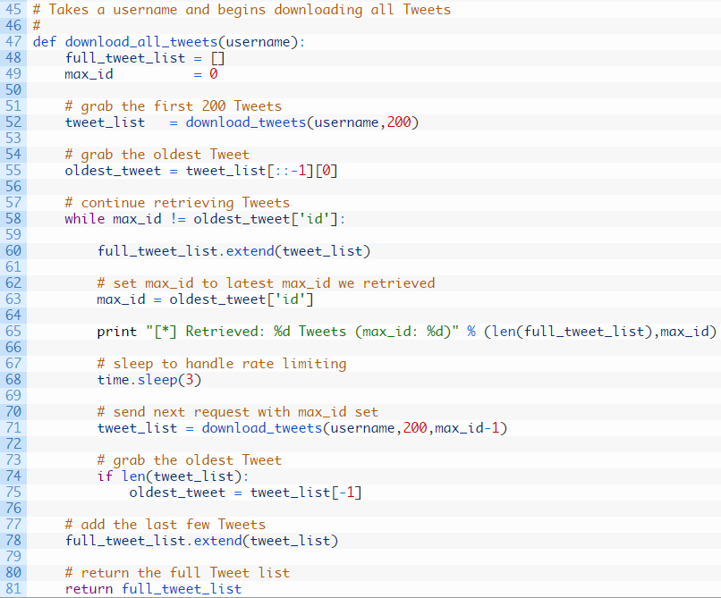
New function – just username parameter
Creates empty list, ready
we use [-1] to grab the last item in a list. This allows us to retrieve the last item in the list, which is the oldest Tweet in the current set of Tweets
here we send off our first request, notice that we do not set the max_id parameter as we are starting at the beginning of (remember beginning means newest Tweet) the user timeline
!= not equal
the beginning of our while loop that continues to execute the code beneath it as long as we are still getting a new max_id value.
Once max_id doesn’t change that means we have hit the end of our timeline
we add the new Tweets we have retrieved to our full_list variable and then set our max_id variable to the oldest Tweet ID
here we are calling the download_tweets function and we pass in our max_id variable minus 1.
if we retrieved some new Tweets, we grab the oldest Tweet and we continue the loop
Notes:
To check if a list is empty:
Eg
a = []
if not a:
print "List is empty“
!= means ‘not equal’
Comparisons: https://docs.python.org/release/2.5.2/lib/comparisons.html

Slide 3
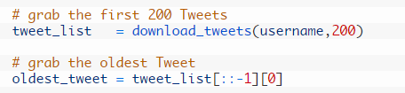
we use [-1] to grab the last item in a list. This allows us to retrieve the last item in the list, which is the oldest Tweet in the current set of Tweets
: = ignore (screen_name)
: = ignore (number_of_tweets)
-1 = grab the last item in the list (of max_id)

Slide 4
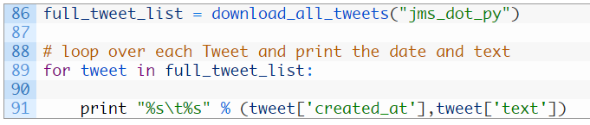
just looping over each Tweet and printing out the date and body of the Tweet.

Slide 5

if len(tweet_list)
This initially confused me, because looks like needs a condition (eg if length is more than x, do y)
But actually, In Python, values that are considered 'empty', such as numeric 0, are considered False in a boolean context, and otherwise are True.
Thus, len(f) is True if f has length, otherwise it is empty.
So this is just saying, ‘if there’s anything in the tweet_list’ …
If f is a standard Python sequence type then the code can be simplified to:
if f …

